Slide 1
GrubQuest
”what do you want to eat tonight”

Slide 2
Description Motivation Results
GrubQuest is a program that helps a user narrow down choices for going out to eat and the cost to get there on Uber.
Helps to solve the question of “what do you want to eat tonight?” and the back and forth that results from that question.
This program helps to weed out places and categories to help you make a quick decision.

Slide 3
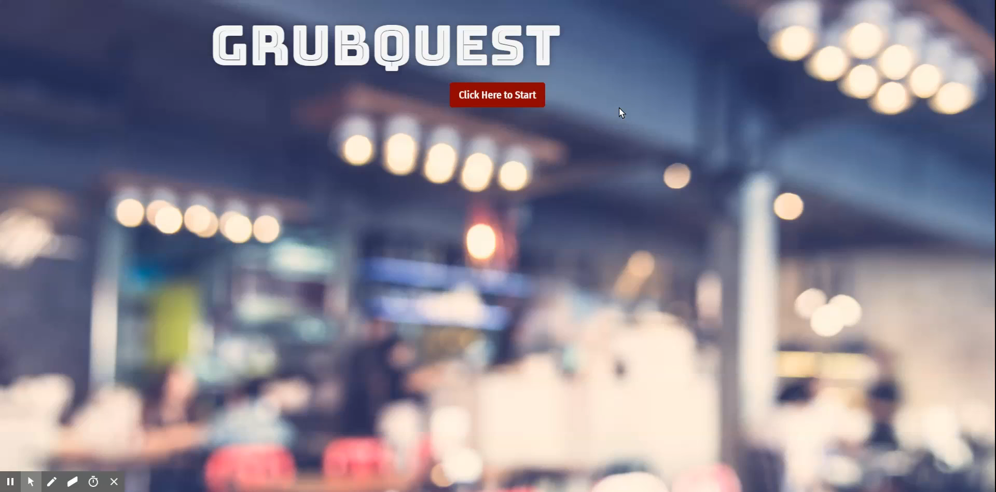
Form Validation and Venue Search

Slide 4
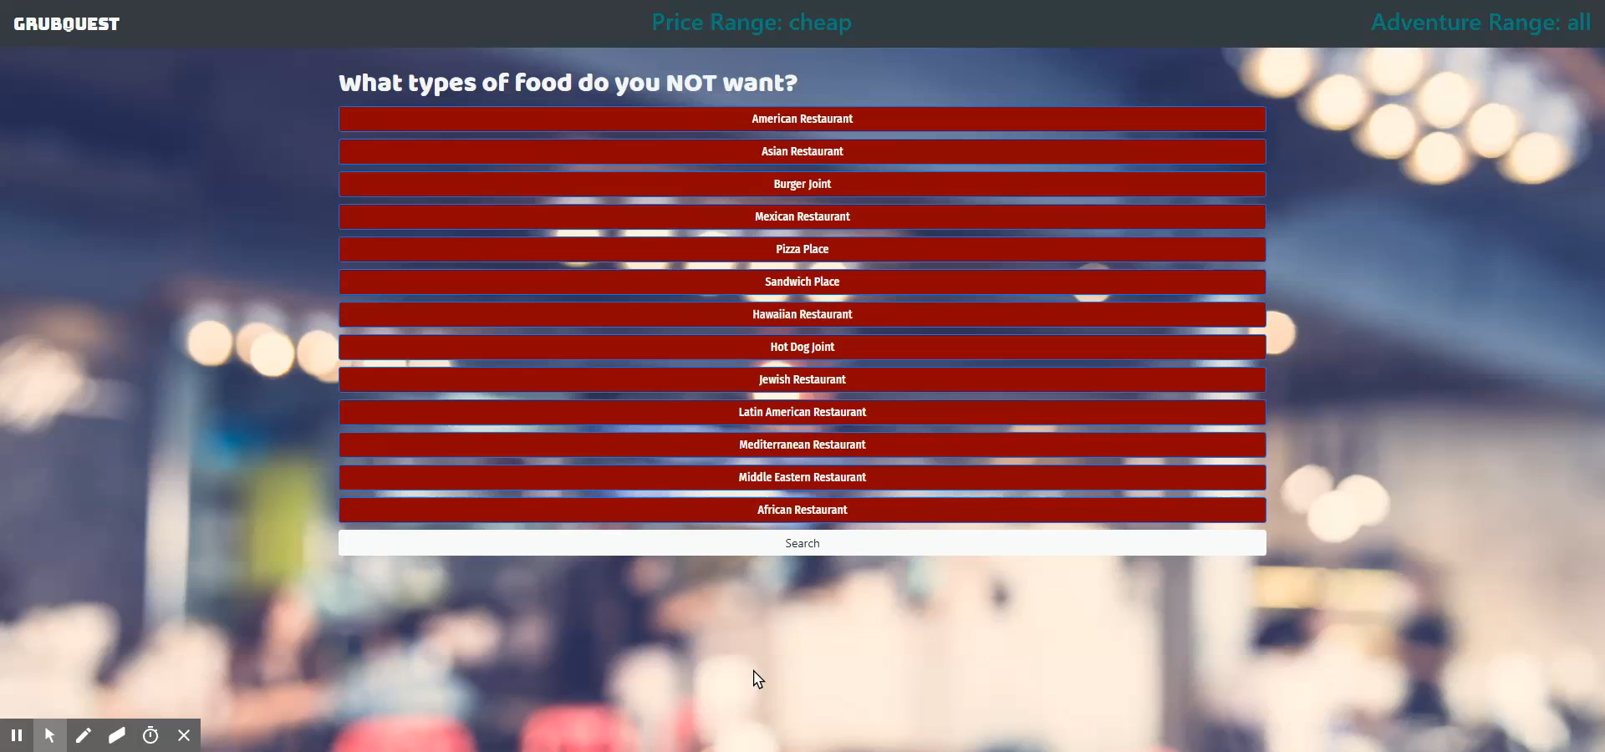
Venue Selection and Search

Slide 5
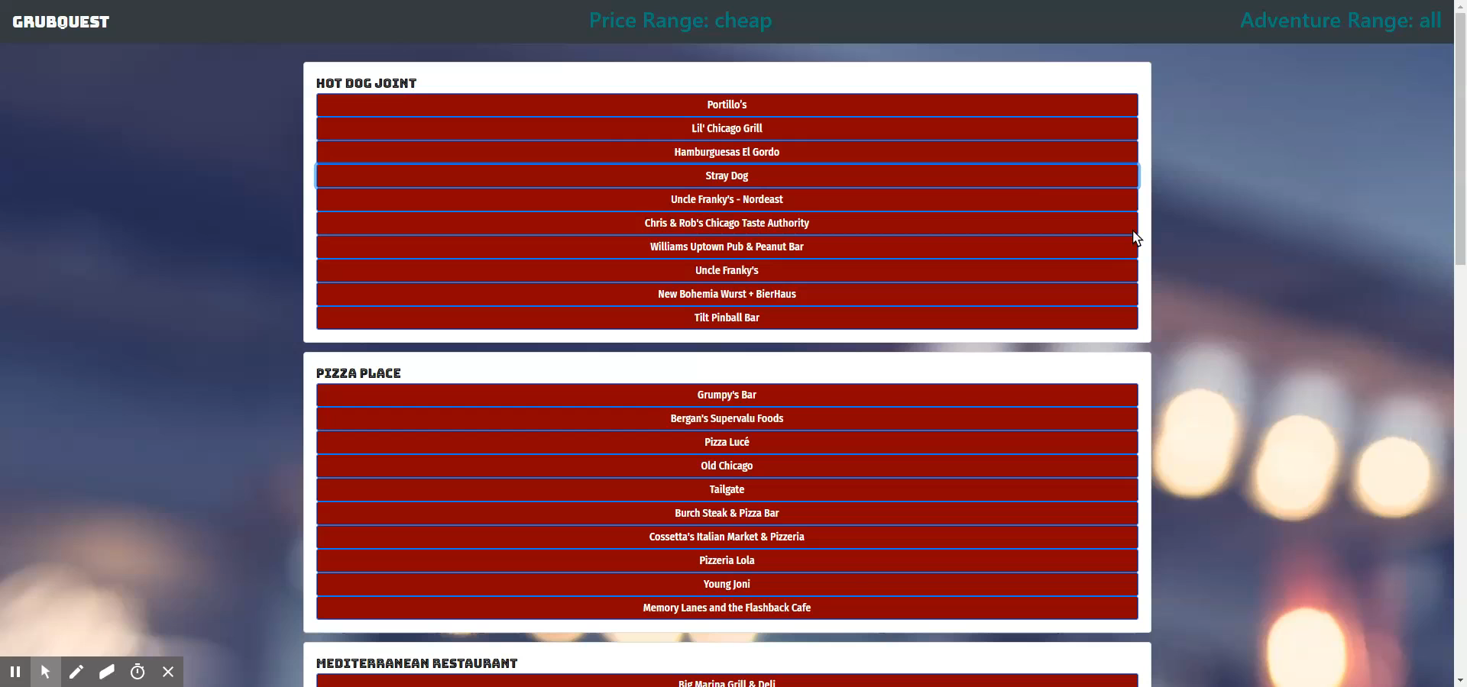
Venue Info

Slide 6
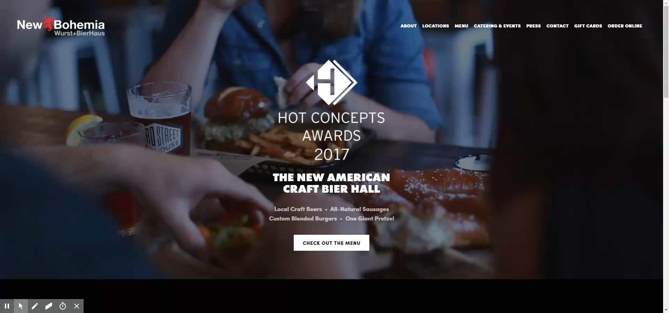
Venue Links

Slide 7
Team Efforts
We brainstormed ideas as a group and settled on Matt’s concept.
We laid out how we wanted to have the website look and function.
We divided up the APIs and Javascript programming.

Slide 8
Individual Responsibilities
Matt – Worked on CSS improvements, appending and removing buttons to the DOM, Uber API set up.
Erik – Foursquare search API and venue detail API. Form enhancements, local storage.
Patrick – Set up HTML, CSS effects, MapQuest API and restaurant info.

Slide 9
Challenges
We initially wanted to use Yelp, but their API does not work on non-deployed sites. We tried a few other things and settled on Foursquare.
The Foursquare API works, but their format is more challenging than Yelp, and their data is limited since it lost popularity a few years ago.
Testing the website was a challenge because we used too many API calls to Foursquare and exceeded our limits for the day which caused other things to not work.

Slide 10
Improvements
Use more API parameters to narrow down the choices more at the beginning to make the options more streamlined.
Using an API other than Foursquare such as Yelp or Google places would make the website more robust and accurate.
Use the Uber API to actually request a ride from the program.
Geolocation and making it more friendly to use on a mobile device.

